Slide 1
Playing is Learning
The Importance of Play in Preschool!

Slide 2
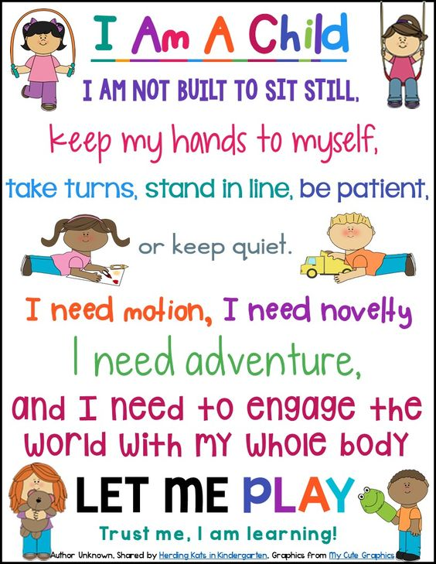
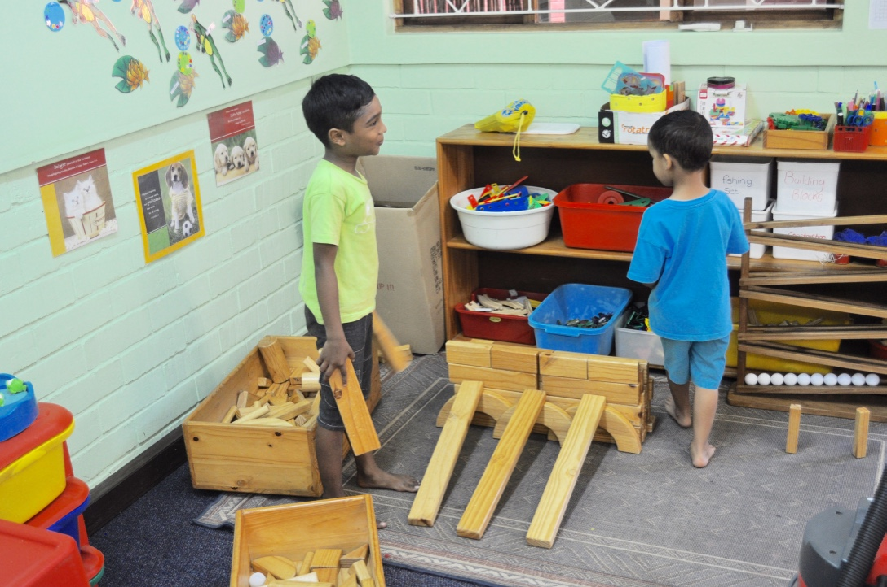
Children learn through Play

Slide 3
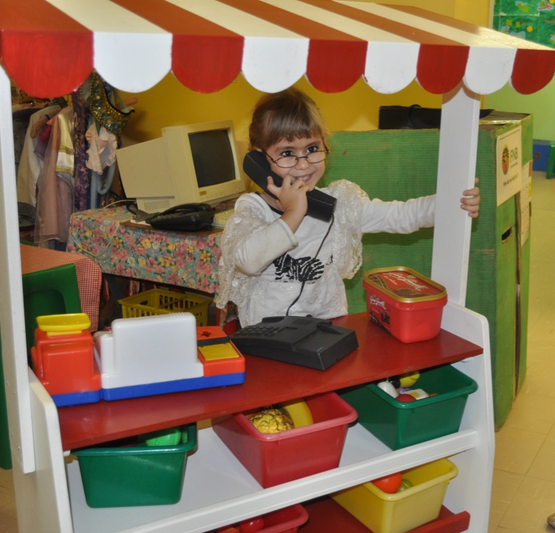
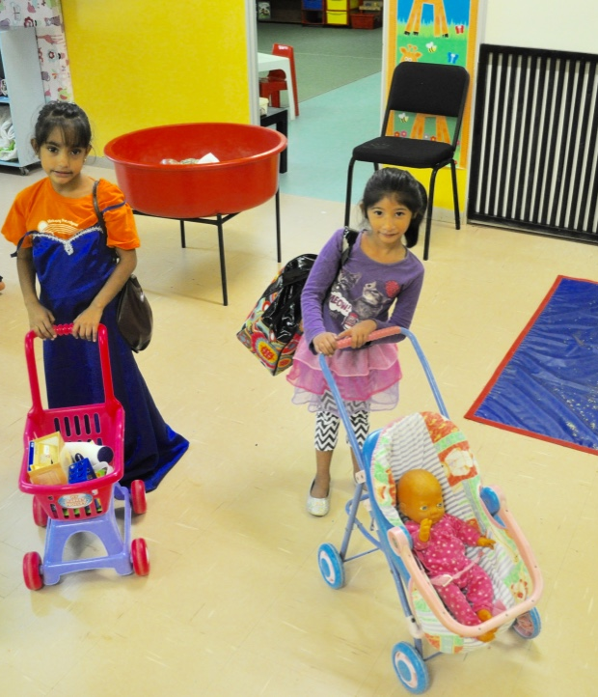
Play is how children begin to understand their world

Slide 4
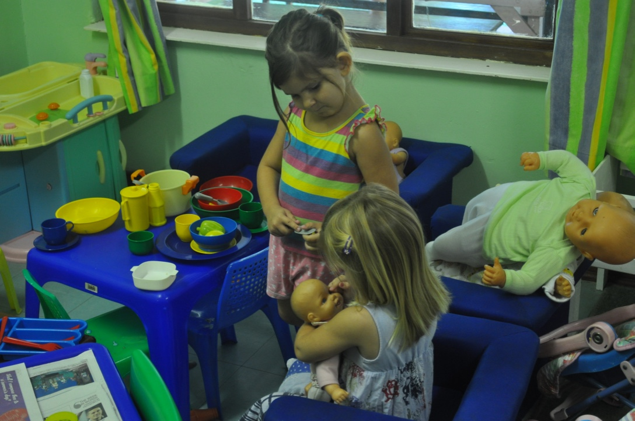
It is the foundation for all learning for young children

Slide 5
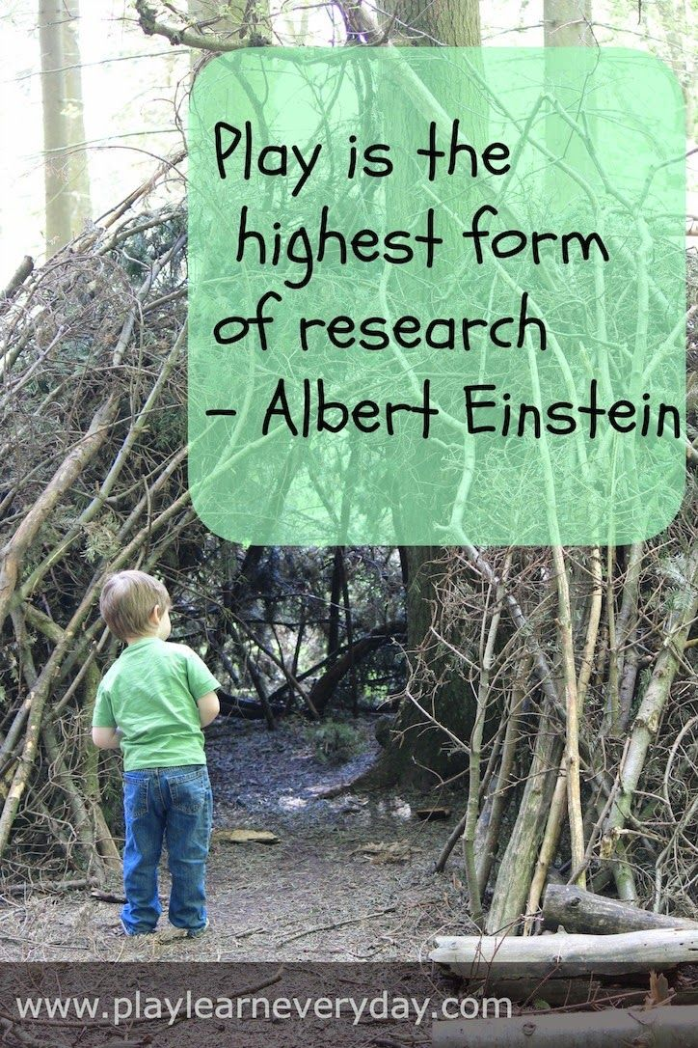
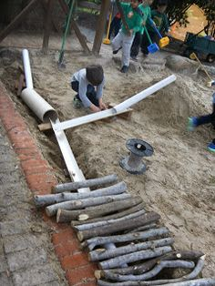
Play is the tool children use to discover and learn

Slide 6
Definition of Play…
Light, brisk or changing movement (pretend you’re a butterfly)
To act or imitate the part of a person or character (play house)
To employ a piece of equipment (play with blocks)
Exercise or activity for amusement or recreation (play tag) fun or jest (peek-a-boo)
The action of a game (duck-duck-goose)

Slide 7
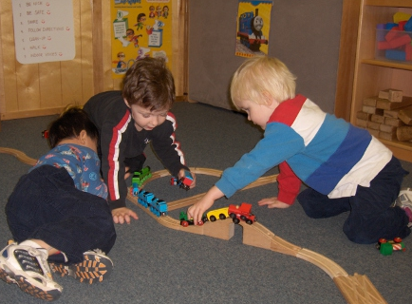
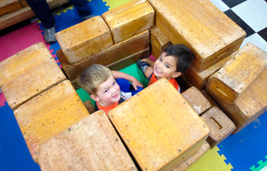
What is Play?
Play is the foundation for all learning for young children, and giving them the time and basic toys, provides them with a variety of valuable learning opportunities.

Slide 8
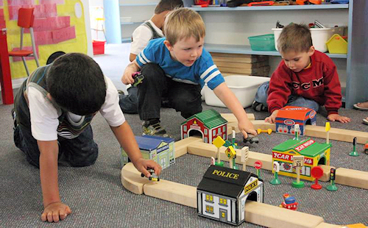
What is Play?
Play is how children begin to understand and process their world.
Children’s Play unlocks their creativity and imagination and develops reading, thinking and problem solving skills.
Children need time
to play effectively.

Slide 9
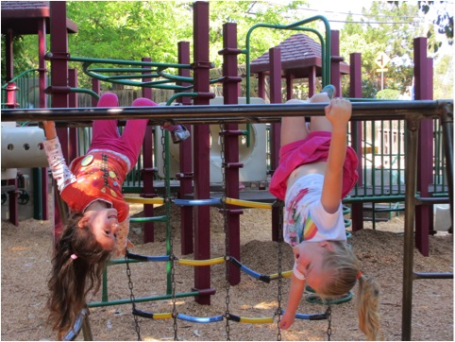
Why it matters!
Children’s Play provides the ‘bedrock’ foundation for learning, and it further develops their motor skills.
Making use of both playground and class- room, encourages children to develop their motor skills during free Play.

Slide 10
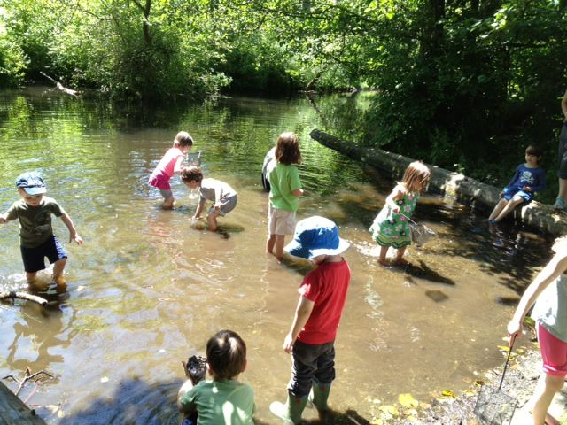
Why it matters!
Play allows curiosity; investigating and discovering the ‘world’ around them.
Children use their senses: seeing, hearing, tasting, smelling, and touching to accomplish their tasks.

Slide 11
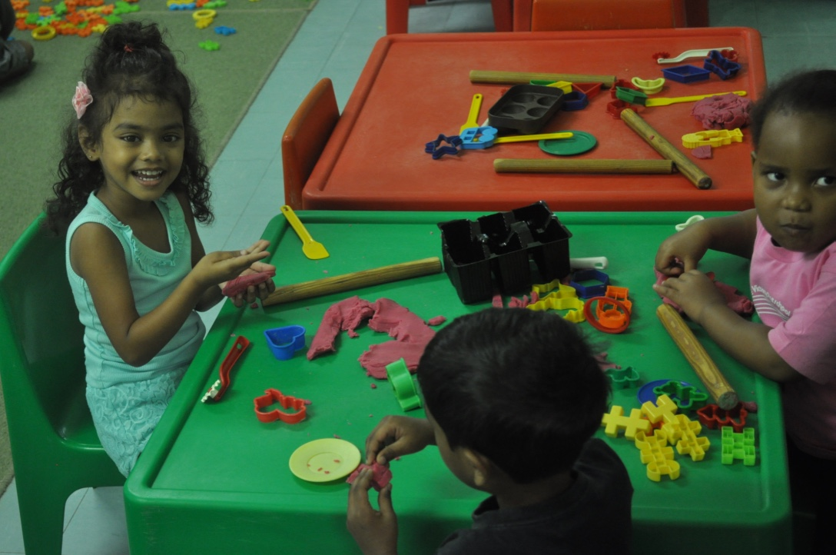
Why is Play so important & what do Preschoolers learn when they play?

Slide 12
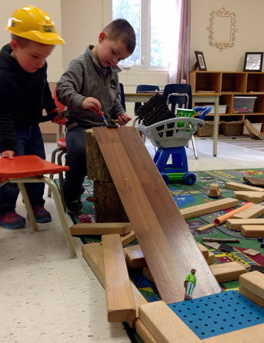
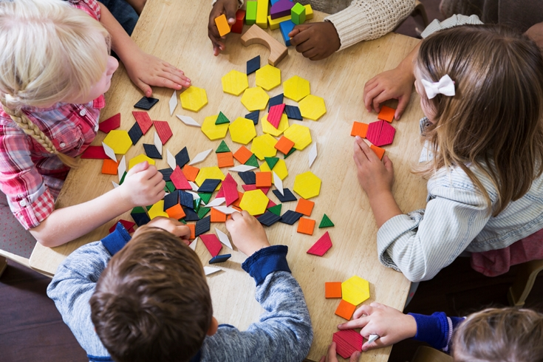
Play is work for Preschoolers
Play is a very effective way of learning and can be used in a way that children will learn in a fun-filled, joyful, atmosphere.

Slide 13
The Teacher’s role
The preschool teacher’s role in the development of Play is critical
Opportunities for daily Play build social, emotional, physical and cognitive strength
Play is linked to growth in memory, self-regulation, language and symbol recognition, as well as increased literacy skills and other areas of academic learning
Ensure that children have many times of varied Play during the day: non-structured and structured

Slide 14
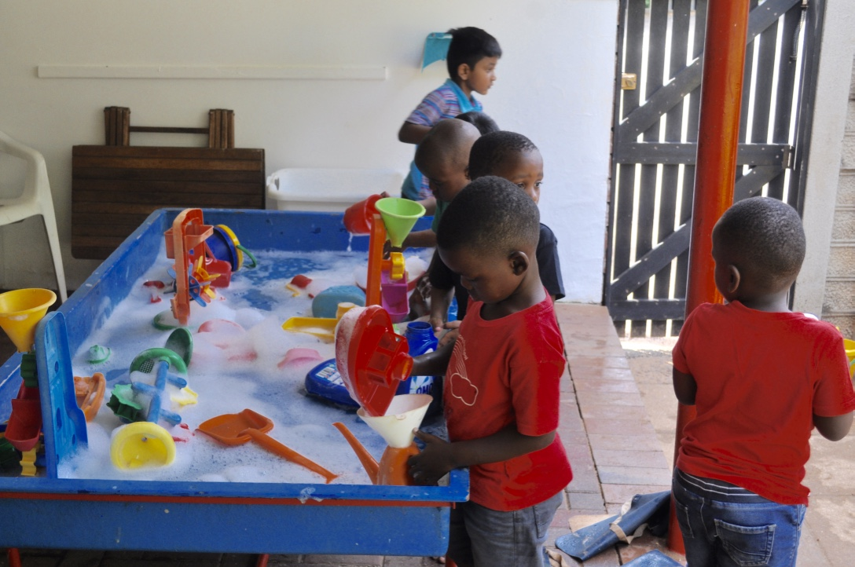
Types of Play!

Slide 15
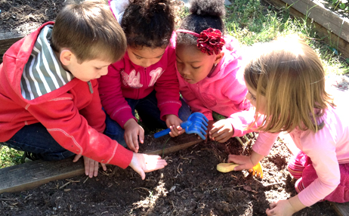
Language and Vocabulary Development
When playing with other children, vocabulary and language skills are fostered. Children will listen and learn the language they hear without even realizing. They learn to use language to communicate meaning as well as picking up new words.

Slide 16
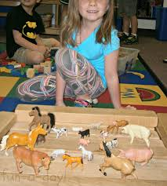
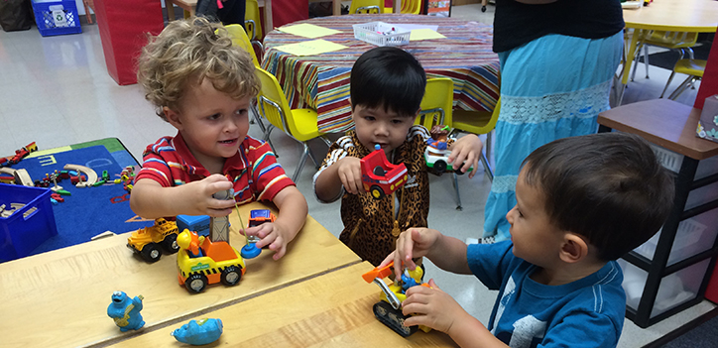
Language Development
Playing with toys: cars, trucks and trains as well as animals provides many new vocabulary words as children learn the names of each, what they do, what they eat or where you can find them.

Slide 17
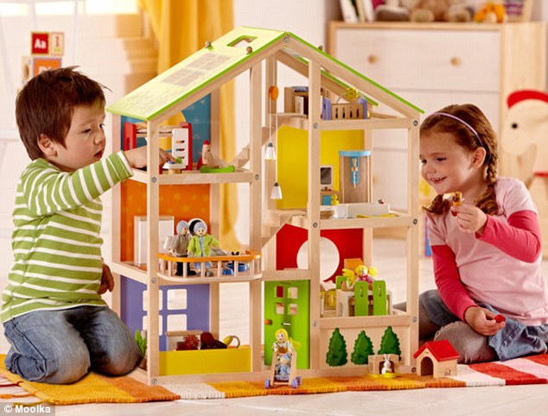
Language Development
Playing with a dollhouse and dolls allows children to re-enact what happens in everyday life, using words and phrases they hear.
Encourage children in verbal and socialization skills during play.

Slide 18

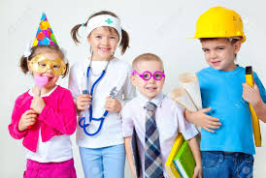
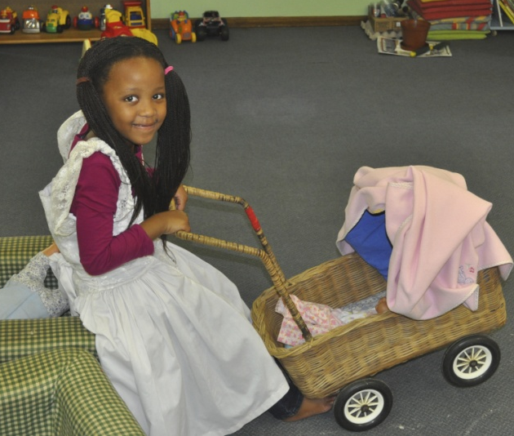
Fantasy and Imagination
Fantasy-directed play with dressing up in costumes, assuming ‘character’ roles and pretending to take on the role of adults, develops social skills.

Slide 19
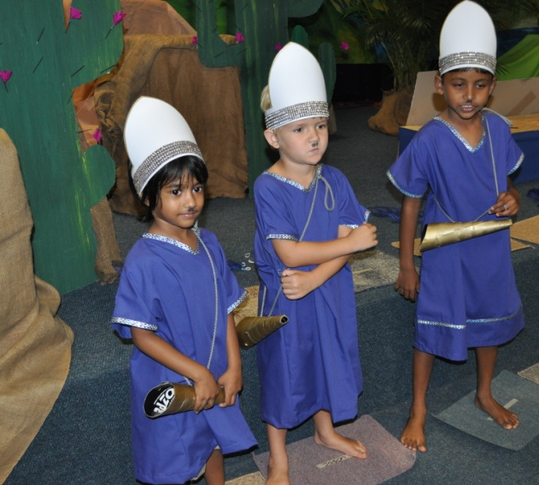
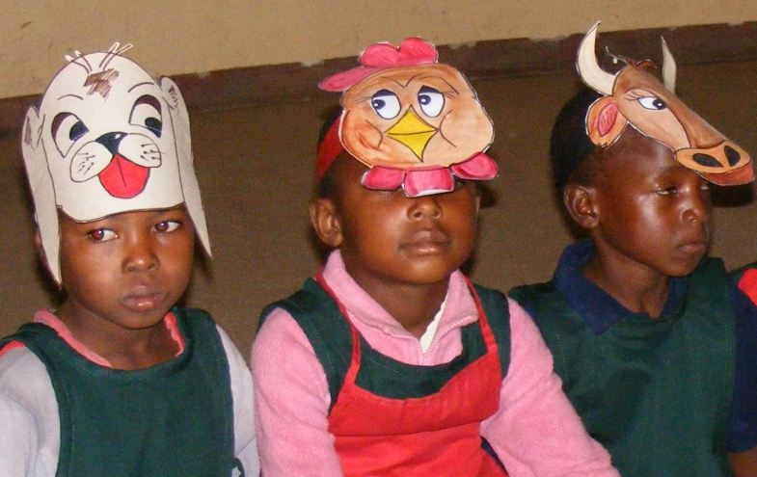
Drama and Fantasy
Using props, hats, clothes and toys to represent characters in stories, and creating imaginary settings is a great outlet for children.

Slide 20
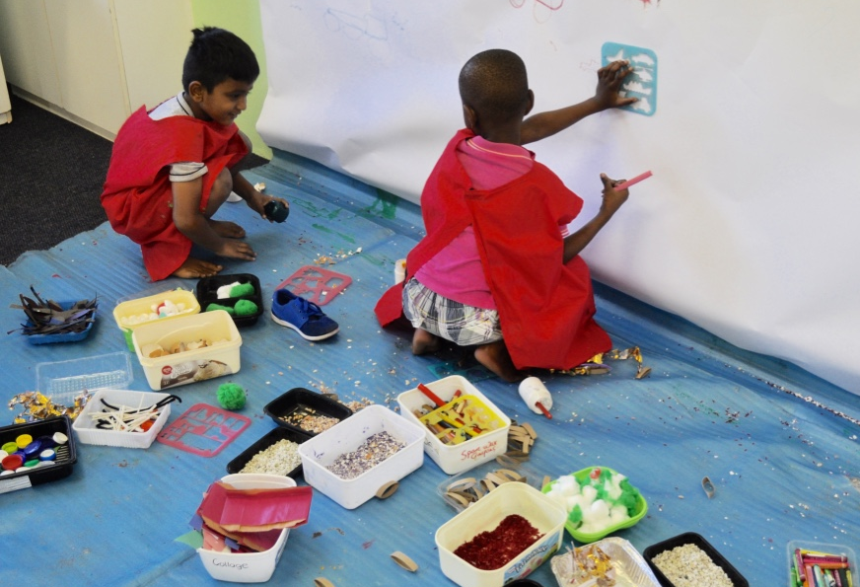
Play and Creativity
Provide children with a variety of craft supplies, such as markers, crayons, scraps of fabric & paper, empty boxes, glue, buttons, scissors, stickers, small plastic bottle tops & paint; Allow them freedom to experiment & Play!

Slide 21
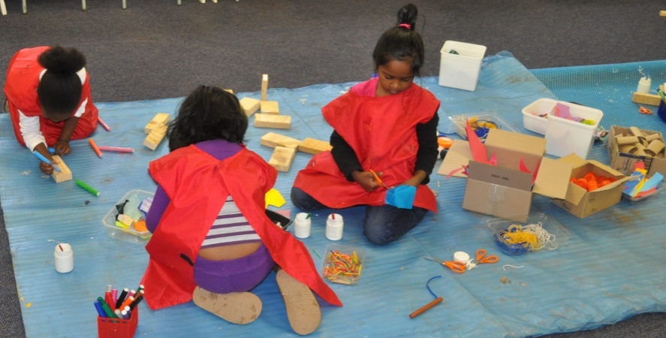
Creativity and Play
Creative Play takes place in the process of using the materials, not in the end product.
This is a chance for children to be creative and an opportunity to use open-ended materials.

Slide 22
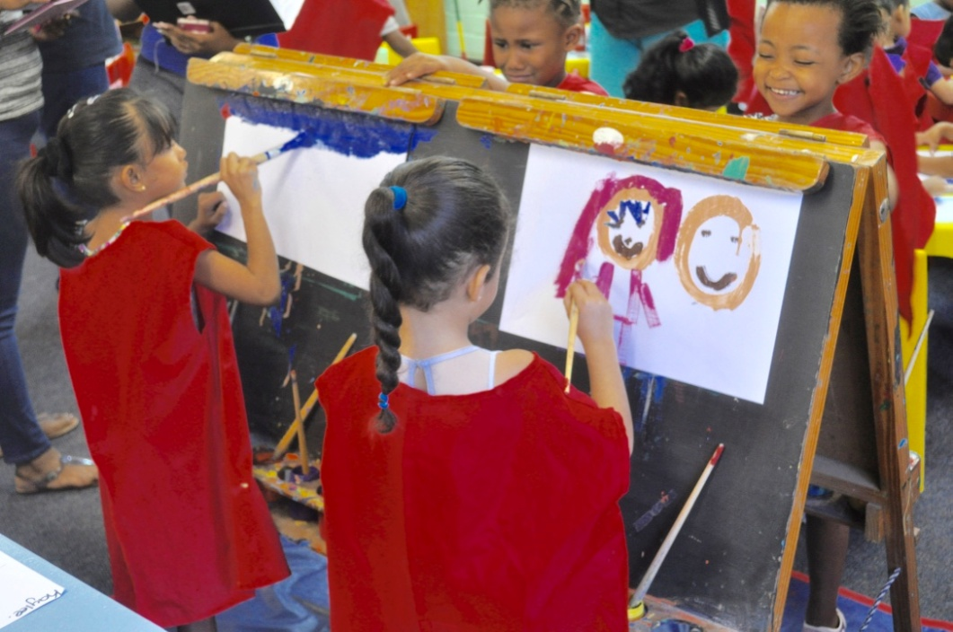
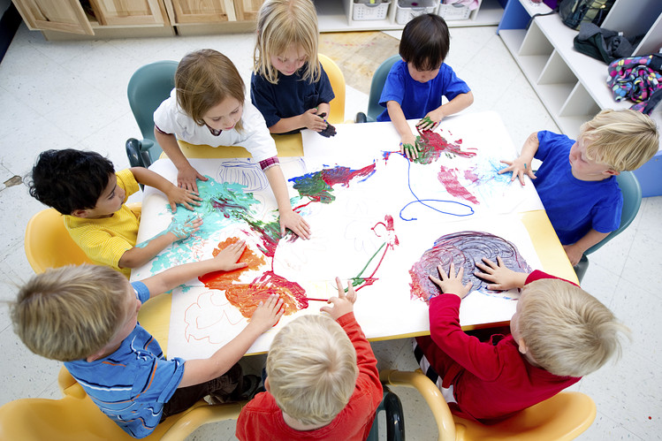
Play and Creativity
During creative Play, allow them to create anything they like and watch their creativity flow!

Slide 23
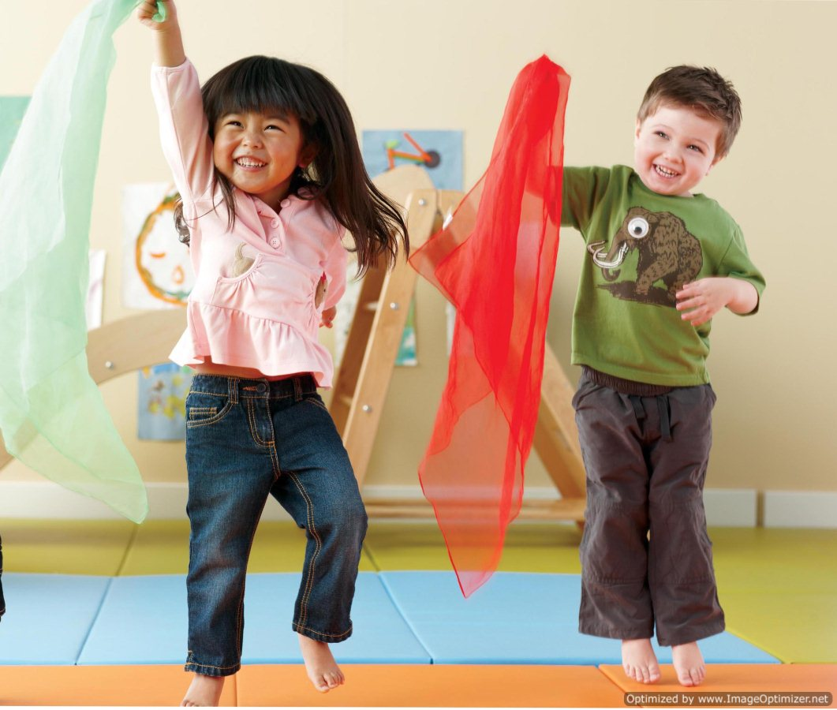
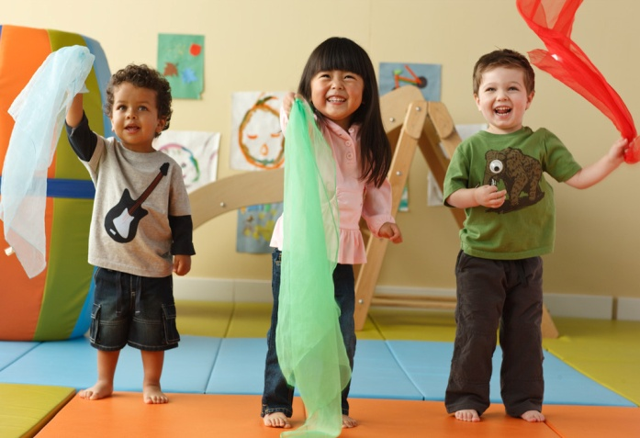
Music and Creativity
Children respond immediately to music and are eager and receptive during Play to experience the joy of moving and dancing.

Slide 24
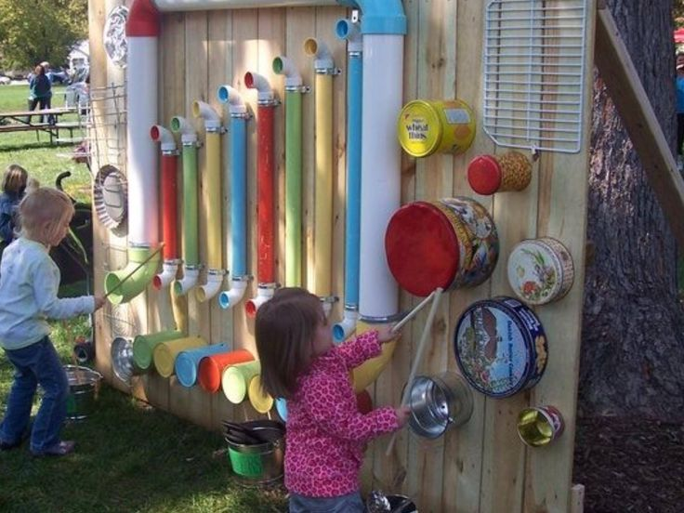
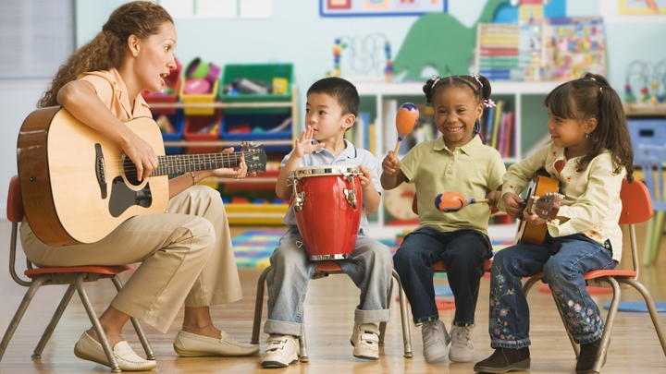
Music during Play
Children thrive in a music-loving environment. They love to experiment with different instruments during Play and hear the sounds they make.

Slide 25
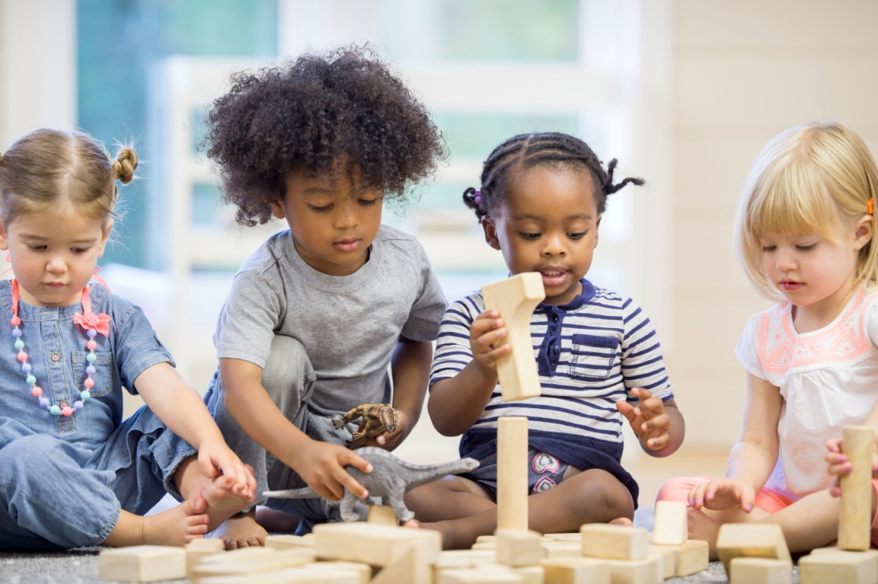
Problem solving
Children can solve complex problems that arise as they play, and they learn a few mathematical principles as well.
Blocks and puzzles are excellent ‘basics’ to provide children with opportunities to foster these important skills.

Slide 26
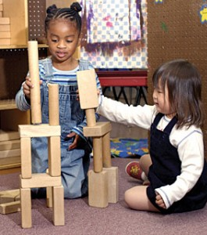
Problem solving & Math
Blocks: Playing with blocks provides for many problem solving scenarios:-
How can we make it balance?
How tall can we make this castle?
Children learn basic math concepts with the various shapes & sizes of the blocks.

Slide 27
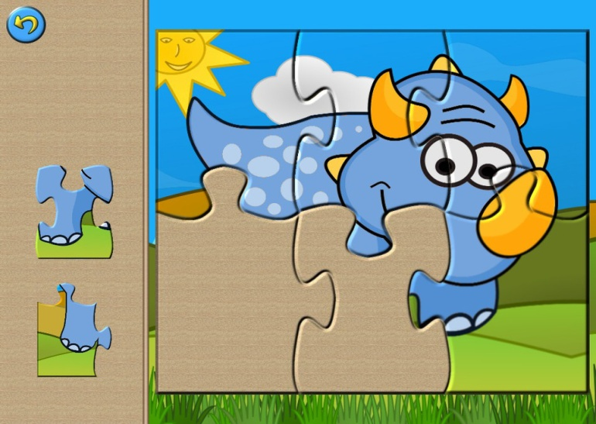
Problem solving and Math
When trying to make puzzle pieces fit, children are gaining important math & problem solving experience.
Learning about sizes (is the piece too big for that spot?) and shapes (does the shape of the piece look the same as the empty space?)

Slide 28
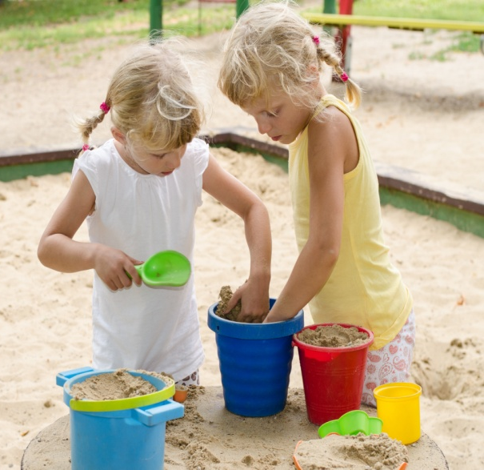
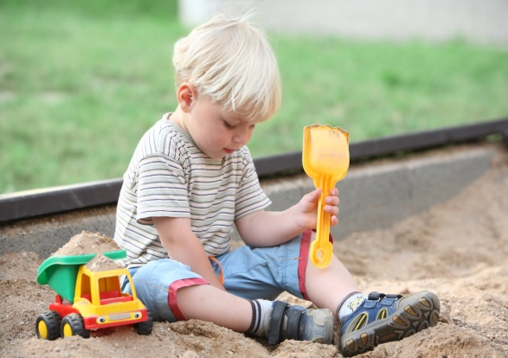
Math in Sand and Water play
Beside the good fine motor skills developing during sand play, math and science concepts are also being nurtured as the children weigh and measure, fill and empty buckets and tip trucks in the sand.

Slide 29
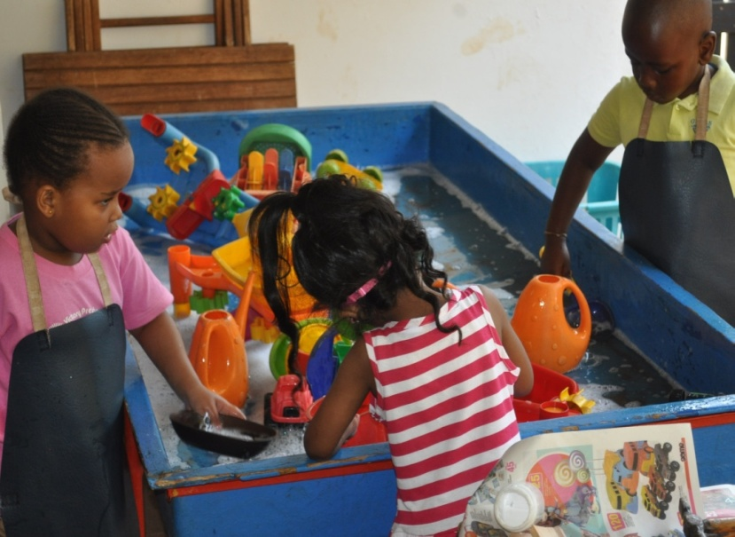
Science in Sand and Water Play
Science is ongoing as children discover and use inquiry skills while playing with water and sand, measuring:- full/ empty, float/ sink, fill up & pour out, using bottles funnels, sieves and other containers.
Mixing water & sand? What will happen?

Slide 30
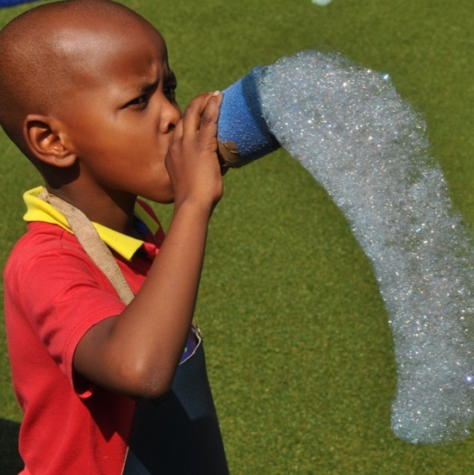
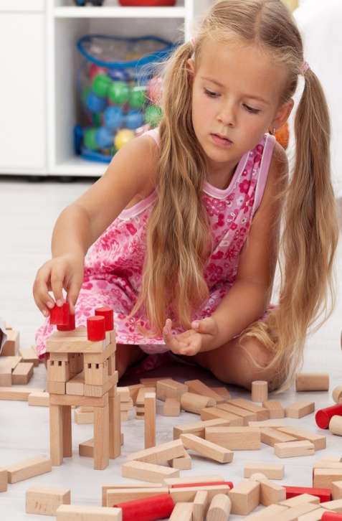

Math and Science in Play
Fun with ‘Bubbles and blocks’ : A simple activity like playing with soap bubbles can stimulate science ‘learning’ while building with blocks establishes a foundation for understanding geometry.

Slide 31
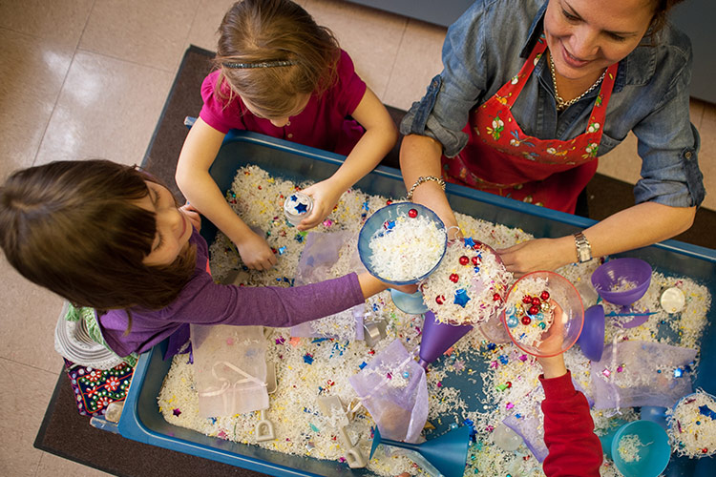
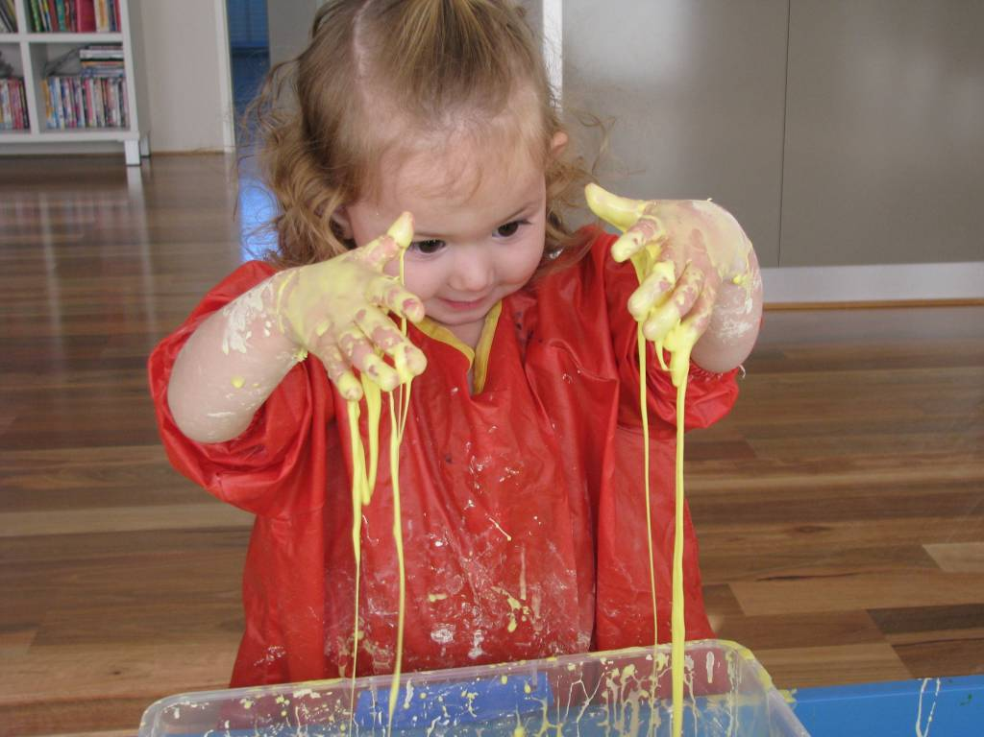
Play and Sensopathic activities
Children learn through their senses and touching, feeling & fiddling, during Play enables them to experience different textures and the sensation of ‘touch.’

Slide 32
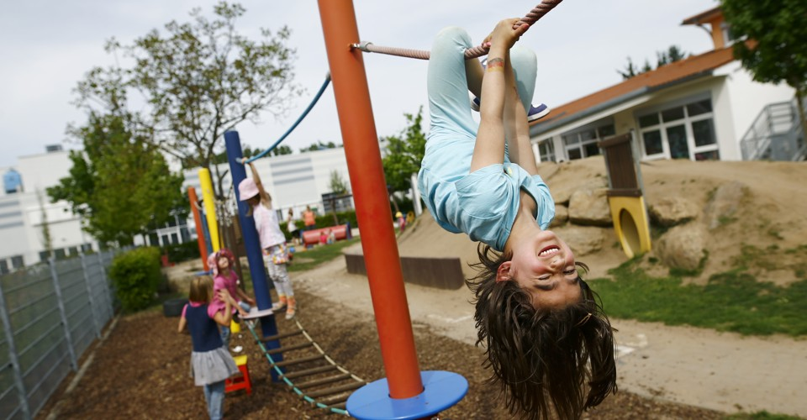

Gross & Fine Motor Development
Both gross and fine motor development occur during play, providing many opportunities to work on strengthening these muscles without children even being aware of it.

Slide 33
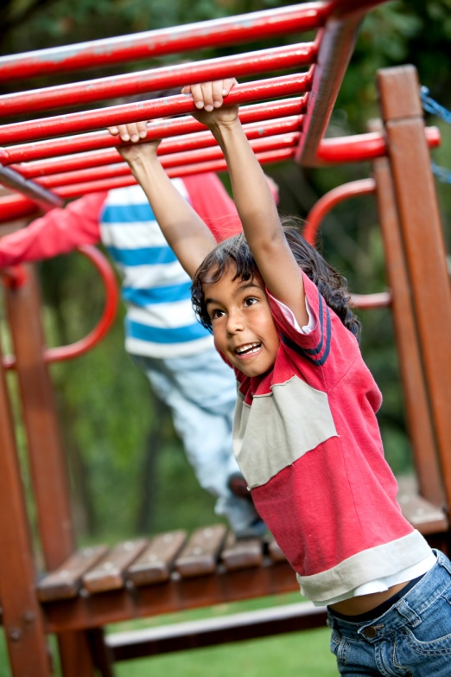
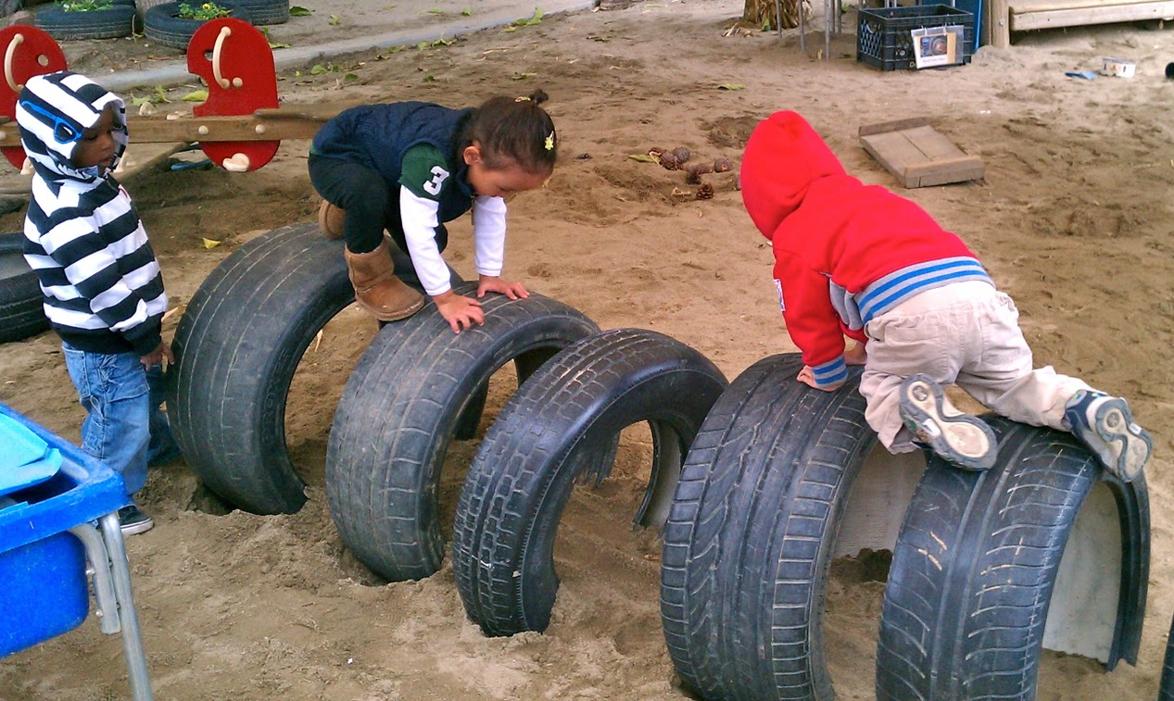
Gross Motor Development
Outdoors: running, jumping, climbing, kicking, sliding, swinging etc are all developing gross motor skills

Slide 34
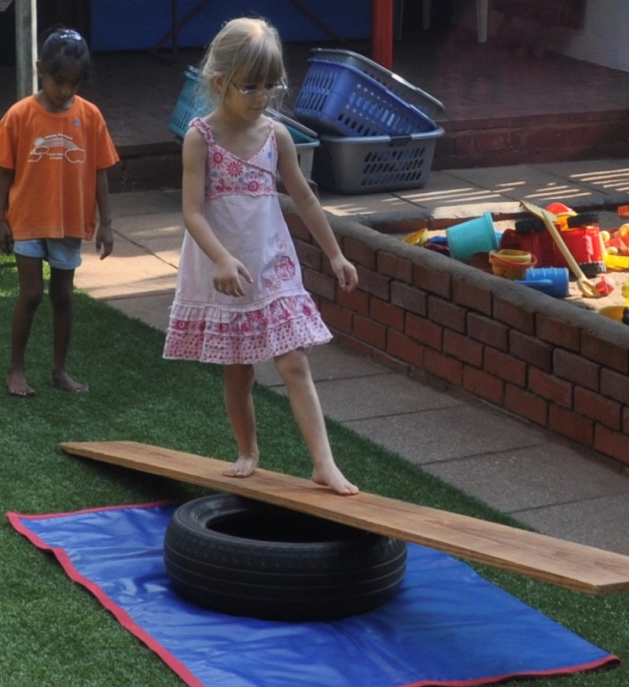
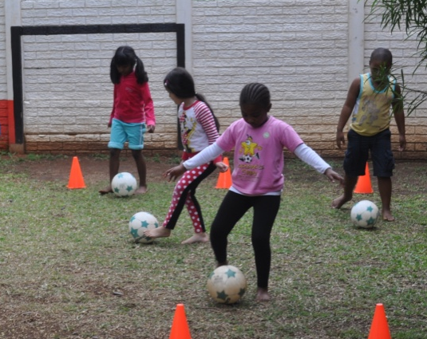
Coordination Development
Kicking balls and walking on balance beams can help children become coordinated. Give them opportunities to practice balancing

Slide 35
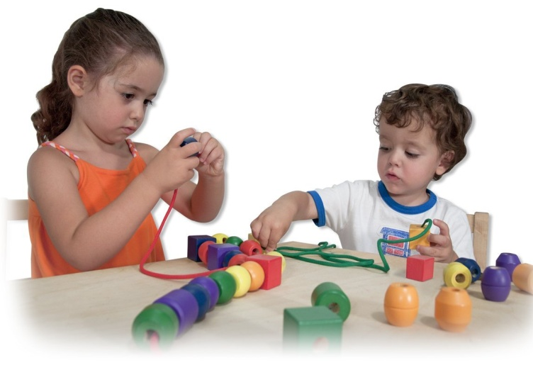
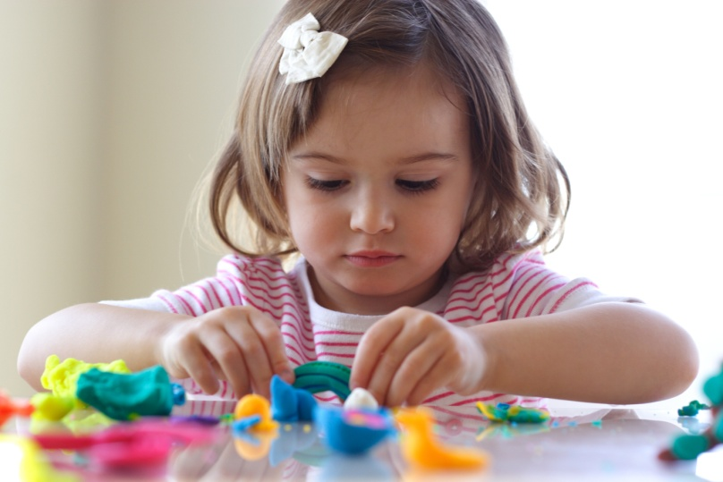
Fine Motor Development
Stringing beads and lacing, enables children to create necklaces while strengthening their fine motor muscles. Lacing cards, peg boards and play-dough also provide fun projects.

Slide 36
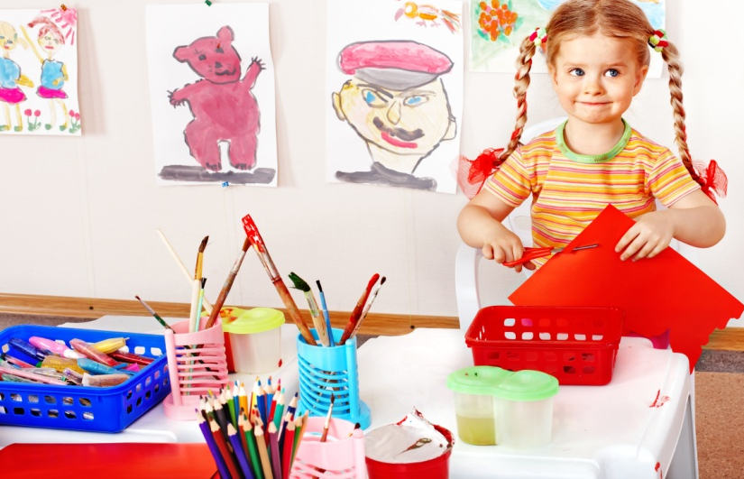
Developing Fine Motor skills
Handling small objects, cutting, sticking, tearing, colouring & threading is a way for children to practice using their hands and fingers which builds the strength & coordination they need for writing skills.

Slide 37

Play & Social Development
Children begin to develop an awareness of differences in people around them & these experiences in Preschool, during Play, provide a foundation for learning how to solve problems and communicate with friends & peers.

Slide 38

Play and Cognitive Development
Cognitive development occurs during Play as children discuss, collect objects, take turns, and share. Adding & subtracting, shapes, patterning, sequencing, use of ordinal numbers are only a few of the concepts being learned.

Slide 39

Social Development during Play
Play also helps build positive leadership qualities for children who are naturally inclined to direct, but must learn how to control impulses.
Play builds a strong sense of self-confidence as they learn in an atmosphere of joy.

Slide 40
Benefits of Play
Play promotes children’s social skills, stimulates their sense of self-worth and encourages collaboration.
Play develops their physical, emotional, social, cognitive & language skills.
Through Play children develop skills they’ll use in their school years.
Play also helps preschoolers master the skills they’ll need for academic subjects later on.

Slide 41
Facilitate Play!
Work to facilitate children’s Play!
Provide props that help children pretend, imagine, create, explore, discover, and communicate as they play.
Schedule large blocks of time for play, allowing important benefits such as persistence, negotiation, planning, problem-solving and cooperation to take place.
Children need to get messy and have Fun!

Slide 42

Power of Play!
As teachers of young children, we need to facilitate the most natural and innate teaching tool at our disposal—Play!
Play is an effective way of learning in a fun-filled and joyful atmosphere.

Slide 43


Playing is Learning!

Slide 44
Are we MAD? (making a difference)
Are we allowing the children in our care to play and learn?
Do we allow them to take off shoes and run bare-foot using these sensations to learn?
Do we allow them to get dirty and messy while they play?
This is why they need to play! To learn by touching, tasting, hearing, seeing & smelling!

Slide 45
Acknowledgements
A place of our own: the importance of play in preschool: www.aplaceofourown.org
How important is play in preschool? Great kids: www.greatkids.org
Play in preschool: why it matters. www.education.com
Why play is important in preschool classrooms: www.parents.com
The importance of play in the preschool classroom-childcarequartely.com
Earlychildhood NEWS www.earlychildhoodnews.com

